Slide 1
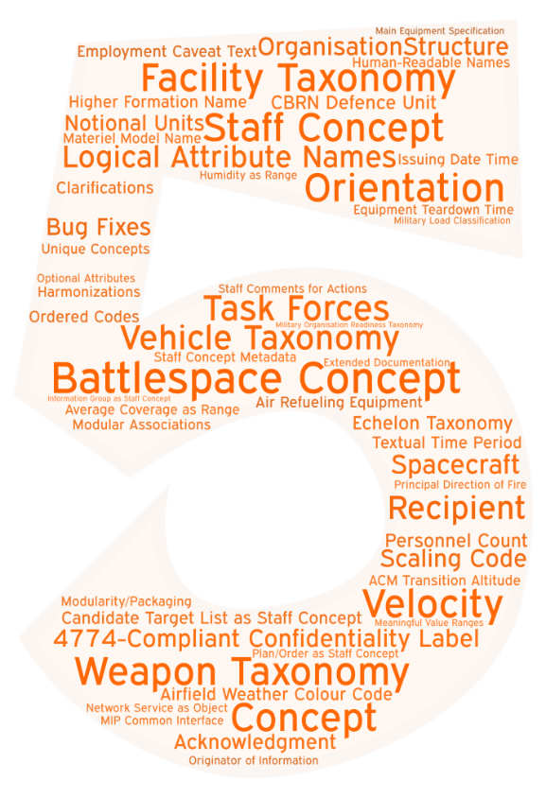
.ONE
Mobility
APP-6(D)
Sensors
Domain / Functional Pictures
Order of Battle / Task Organisation
Task
Planning
Cultural Property Protection Sites
Control Features
Acknowledgment
Location / Geometries
Dismounted
Individuals
Airport / Airbase
Adopted by MIP4.3-IES and NCDF – Validated at CWIX 2020 – Released in September ‘20

