Slide 1
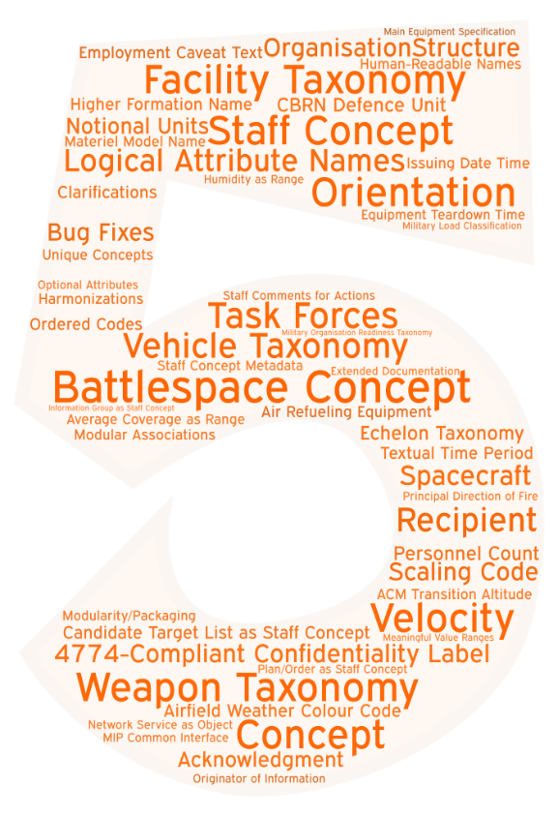
.TWO
Validated at CWIX 2023 – Adopted by MIP4.4-IES and NCDF – Released in September ‘23
Air Force Extensions
Modularization & QA
Alignment with APP-6(D)
CIS SMC / C2 Info Exchange
Extended Weapon Taxonomy

